Slide 1
Continental European Constitutional and Legal History: The Germanic Laws: Æthelberht
Lecture 3
Click here for a printed outline.

Slide 2
Non-Roman Law in the Roman Empire
“Pur avoider le stuffing del rolls ove multip
Citizen and non-citizen, mixtures of Roman and non-Roman law.
The example of Greco-Roman Egypt
The mercantile law of the Eastern Mediterranean, e.g., the giving of arrha or earnest money.
Celtic elements in the West? The Ligurian inheritance law?
Bottom line: the most important non-Roman and non-canonic elements in Western European law that are not the product of medieval and modern developments are probably, at least in some sense, Germanic in origin.

Slide 3
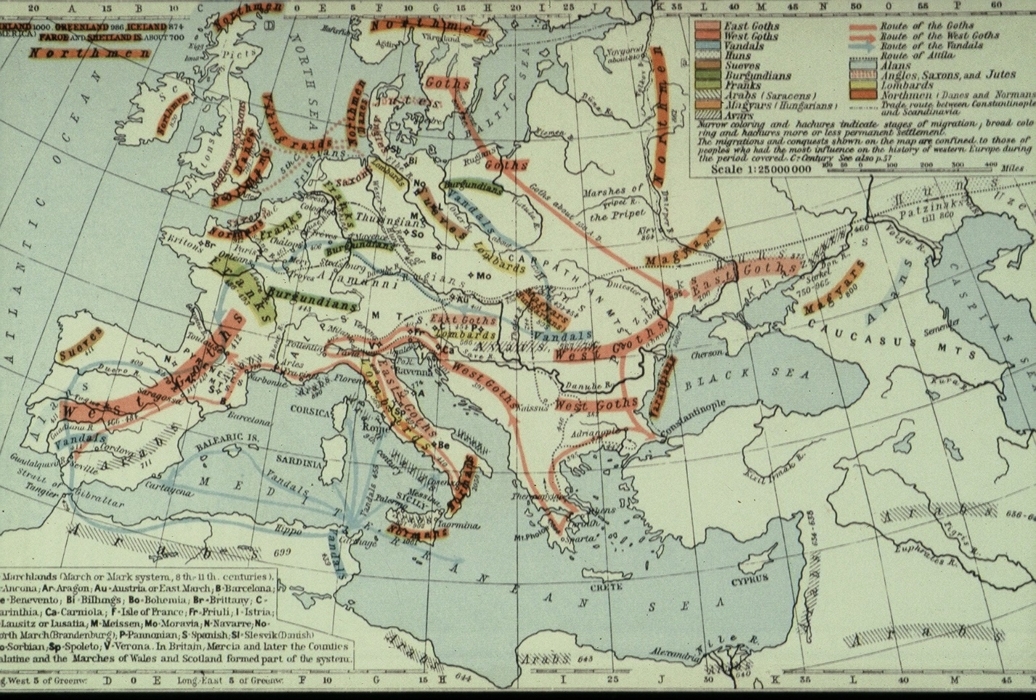
The Germanic Invasions
“Pur avoider le stuffing del rolls ove multip
The map might be entitled all-hell-breaks-loose, and there are even more inelegant ways to describe it. As we will see, the map probably exaggerates the amount of disruption, but it does show that between the years 150 and 1000, a great many tribes, mostly, but not exclusively, Germanic, made their way into what was, or had formerly been, the Roman empire in the West, and this development had far-reaching consequences for Western European history and particularly for its law.

Slide 4
Germanic language groups
West | North | East
OHG | ONorse | Gothic
OSax
ONeth
OFris
OEng

Slide 5
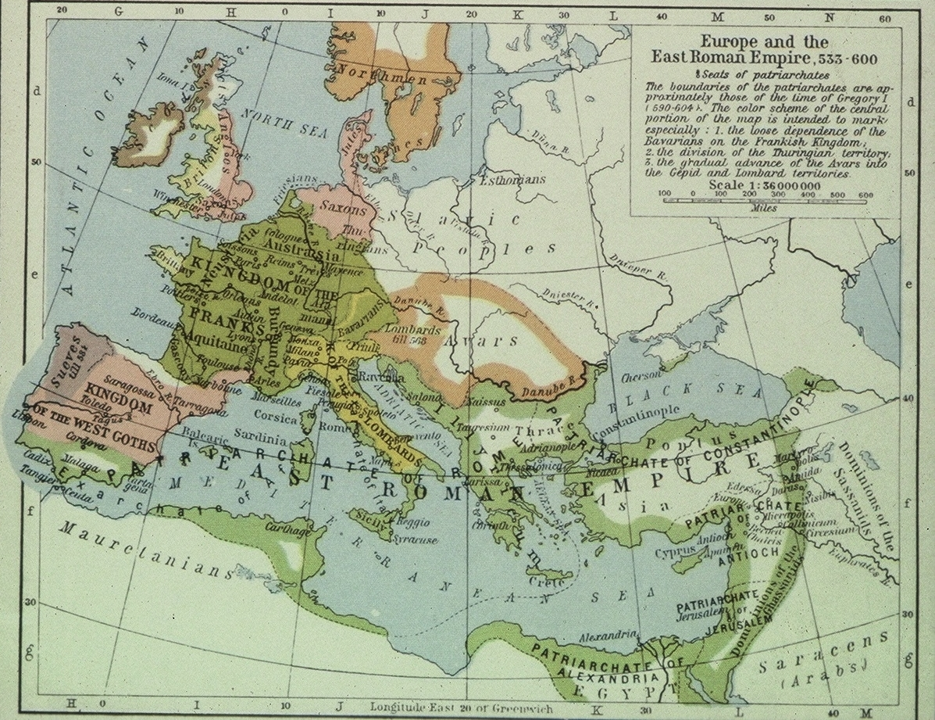
The Germanic kingdoms in 600
West (N. to S.): Anglo-Saxons, Franks, Visigoths. Center: Saxons, Franks, Lombards. East: Saxons, Thuringians, Bavarians.

Slide 6
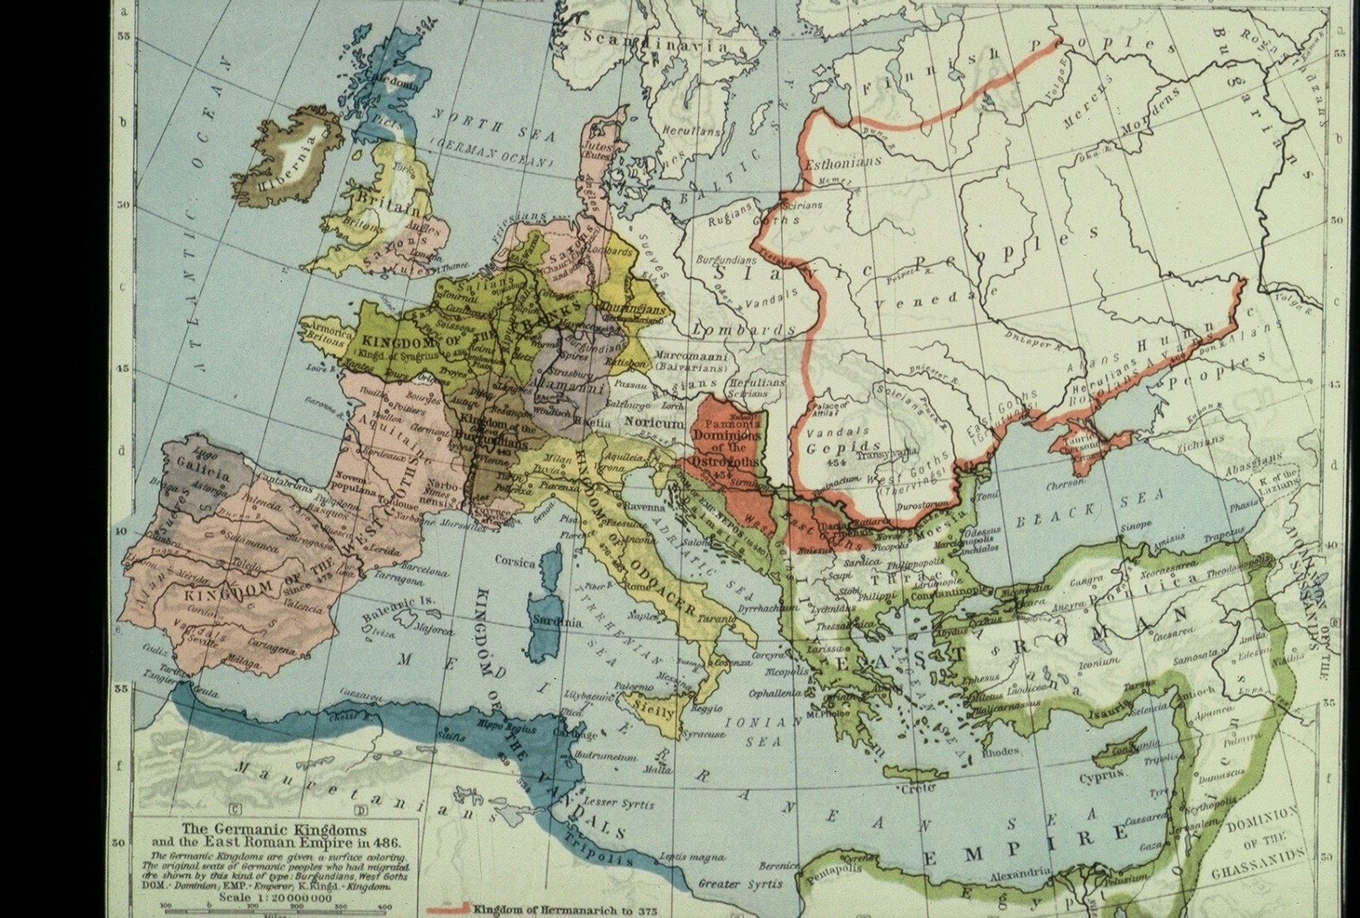
The Germanic kingdoms in 486
West (N. to S.): Anglo-Saxons, Franks, Visigoths. Center: Saxons, Franks, Alemanni, Bugundians, Odoacer. East: Saxons, Thuringians, ???, Ostrogoths.

Slide 7
The position of the Germanic ‘tribes’, c. 200 AD
North Sea | Rhine-Weser | Elbe | Oder-Vistula | Scandinavia
Angles | Franks | Alemannians | Goths | Norse
Saxons |  | Bavarians | Burgundians
‘Jutes’ |  | Lombards | Vandals
Frisians

Slide 8
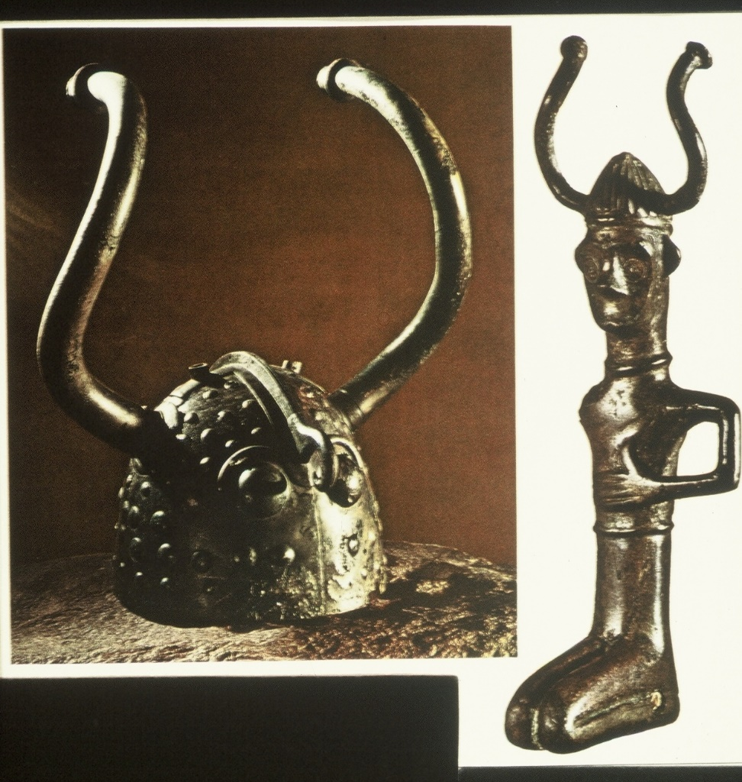
What Were These People Like?
Designed to inspire awe, this bronze helmet unearthed at Viksoe in Denmark boasts curved horns and two staring eyes (the Vikings of history did not wear horned helmets). The four-inch-high kneeling figure in Danish costume (right) wears a similar helmet, suggesting that such a headpiece was an important adjunct to the allure of a Bronze age warrior. Neither has been dated precisely, but both come from the period before our era and may be as early as 500 BC. This is clearly from the time before the Germanic peoples had any contact with the Romans.

Slide 9
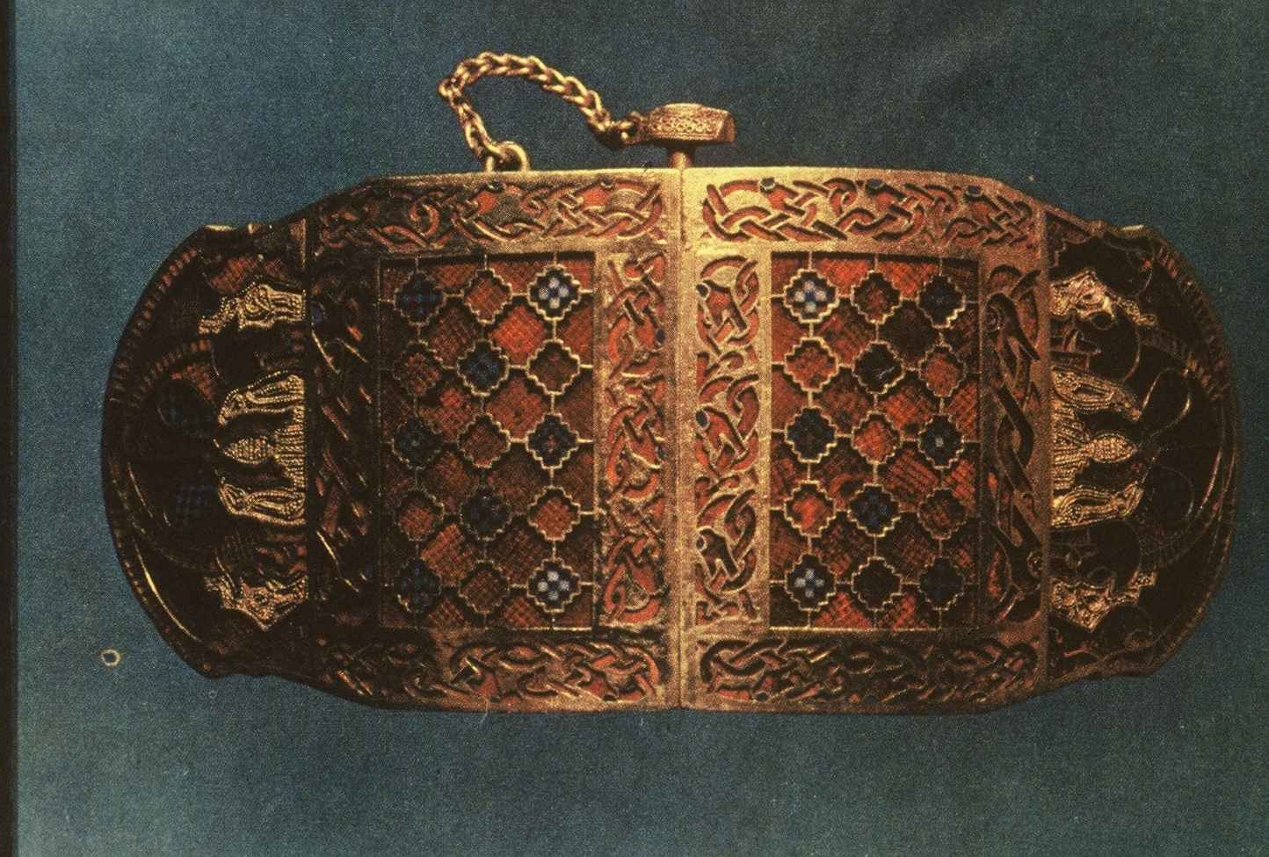
What Were These People Like? (cont’d)
Belt buckle from a ship burial at Sutton Hoo, Suffolk. Seventh century. The artwork here is Germanic, but we can’t be sure that there is not some Roman influence. Even if the Germanic peoples came into an area which the Romans had left, there was plenty of stuff around that showed what they had done.

Slide 10
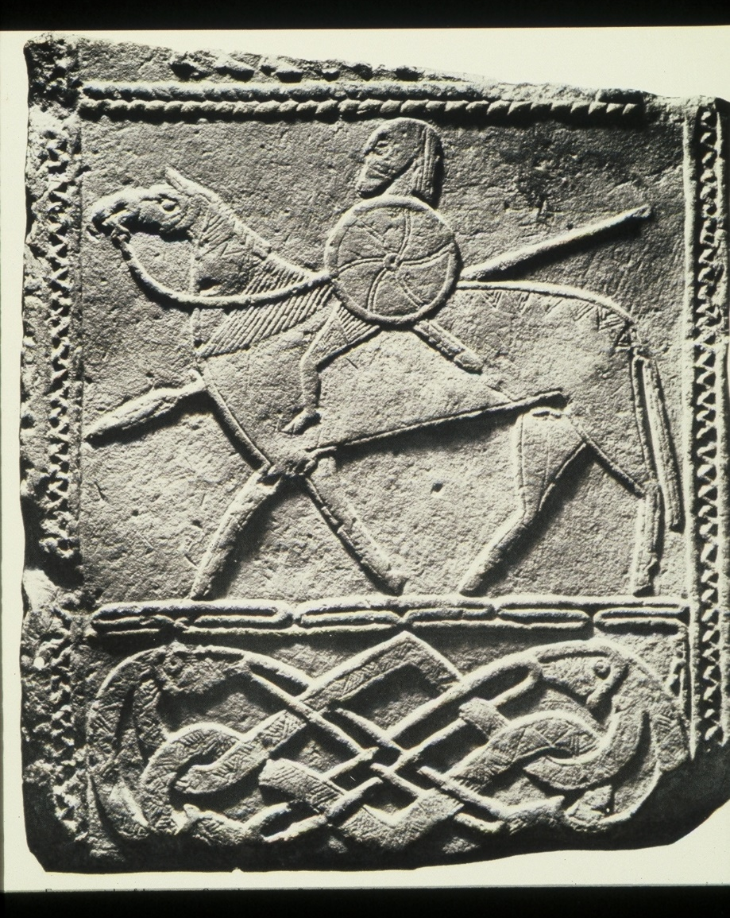
What Were These People Like? (cont’d)
Funerary stele of armed and mounted horseman; note the serpent decoration at the bottom horseman. Seventh century. Sandstone, height 30 3/4”. From Hornhausen (west of Magdeburg, probably Saxon at this time or Thuringian). There seems to be considerable disagreement about date and function. It is now being argued that it comes from a church screen. What is clear is that comes from an area that the Romans never reached.

Slide 11
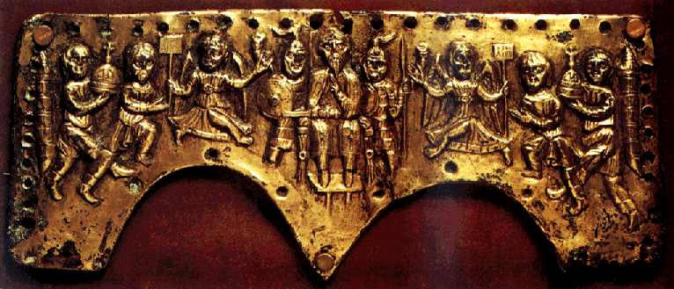
What Were These People Like? (cont’d)
Helmut plaque of Agilulf, the first real king of the Lombards, who united the dukes in opposition to the Franks, 591–616, hammered relief of gilded copper. Agilulf is shown holding court, with winged victories on the sides and cities bringing tribute. The detail shows him guarded by two warriors.

Slide 12
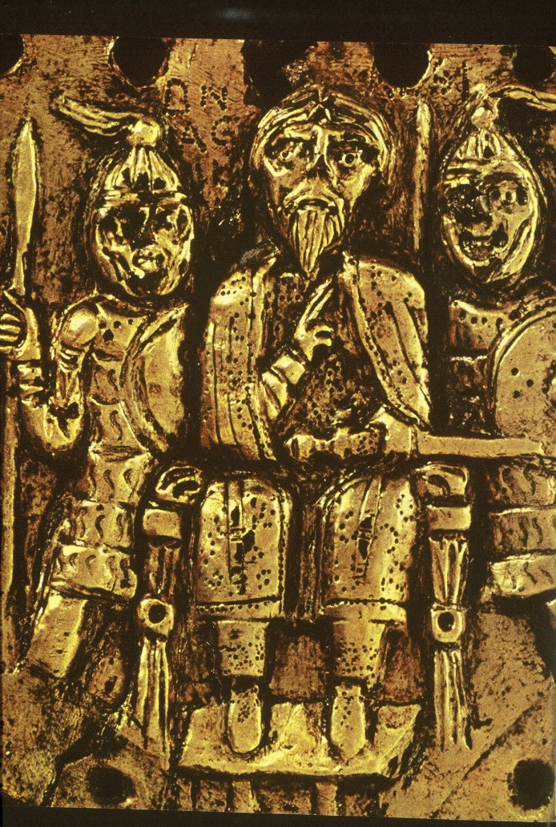
What Were These People Like? (cont’d)
The detail shows Agilulf guarded by two warriors.

Slide 13
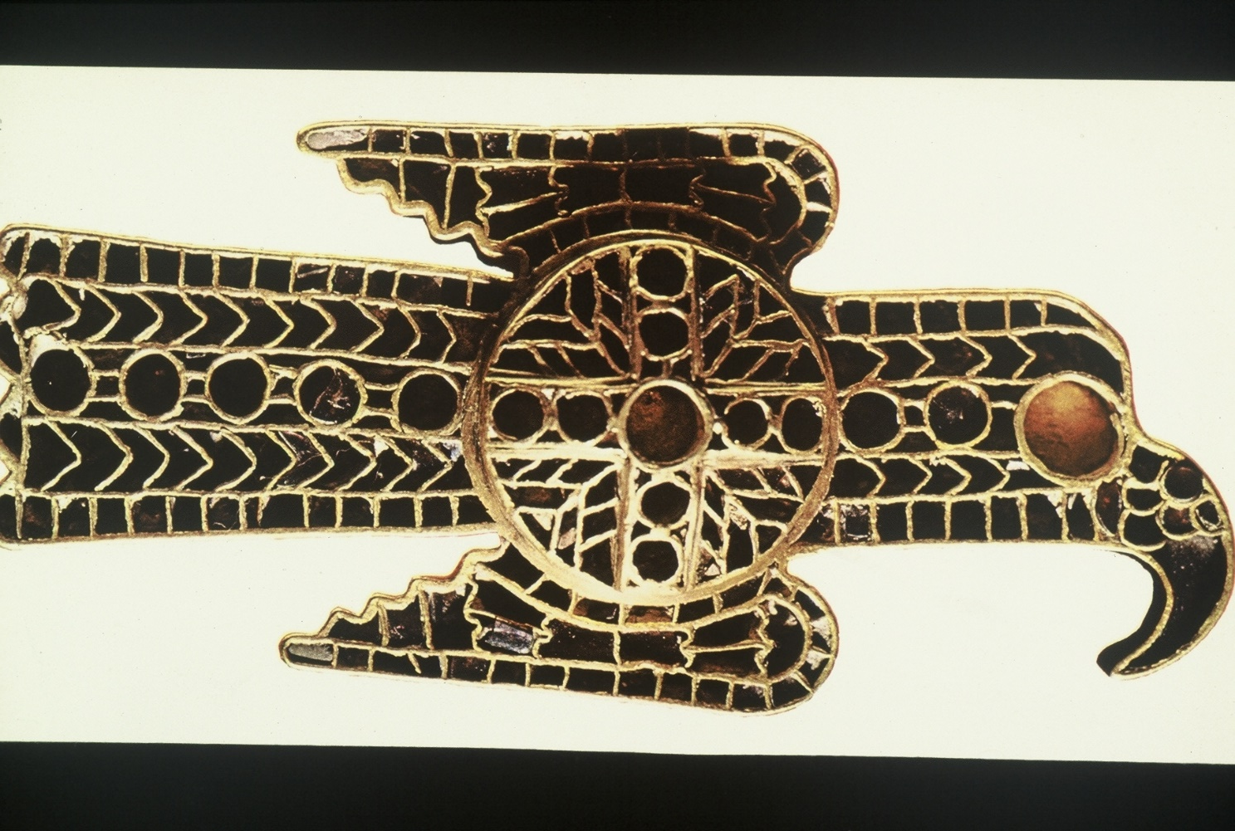
What Were These People Like? (cont’d)
Cesena Bird Brooch, Ostrogothic, gold and precious stones, cloisonné technique with almandines, early 6th c. The pin combines the stylized bird motif popular among Germanic peoples with a Christian cross; the filigreed metal work, set with garnets, was undoubtedly borrowed from Byzantine art work.

Slide 14
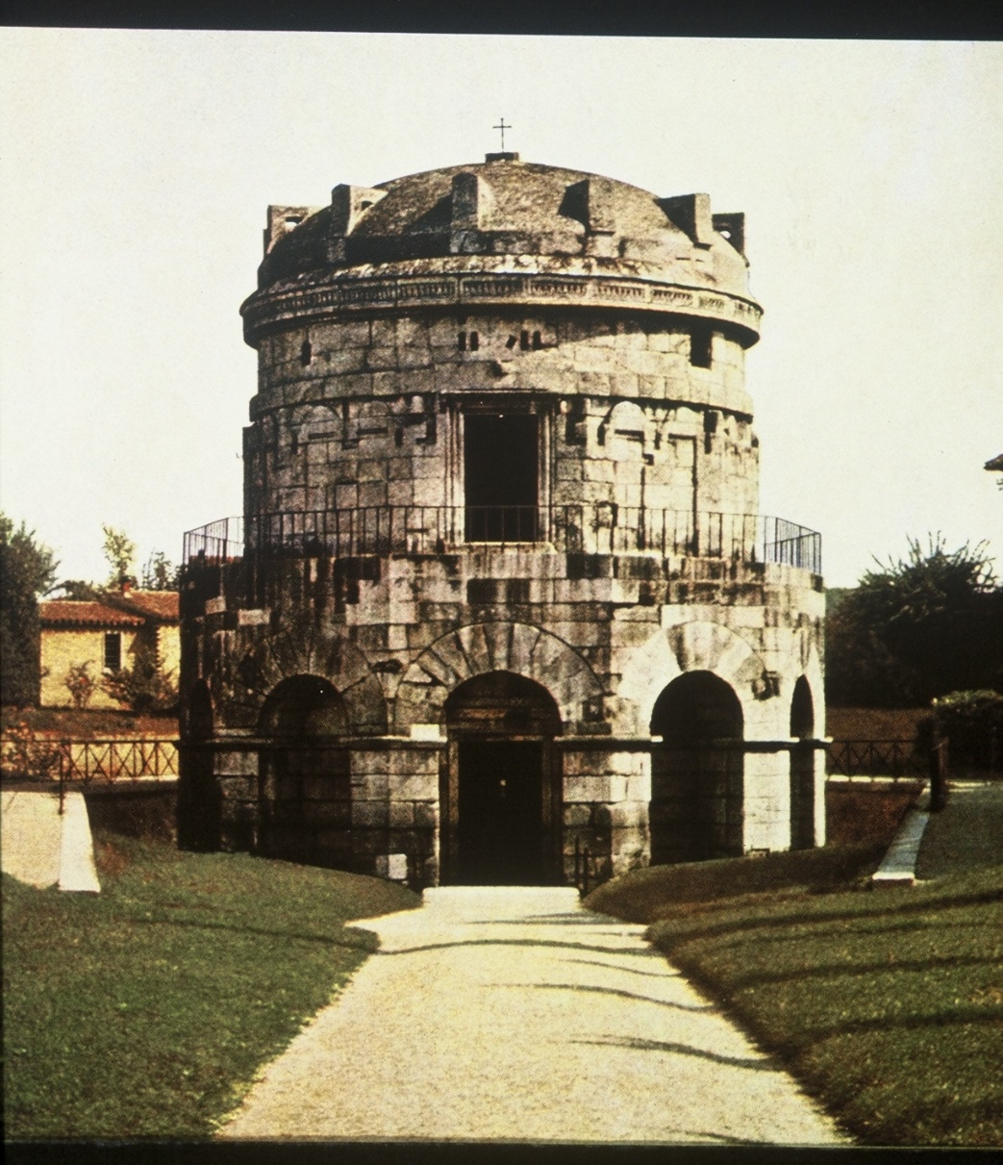
What Were These People Like? (cont’d)
Mausoleum of Theodoric the Great. Before 526. Ravenna. Roman architectural elements put together to make something that is not Roman. The inside much more Roman.

Slide 15
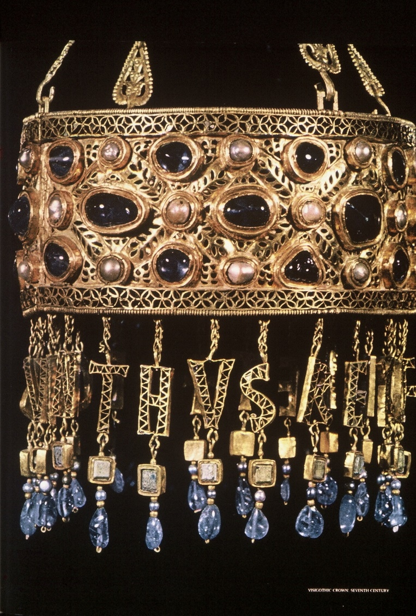
What Were These People Like? (cont’d)
Votive crown of King Recceswinth (653 X 672), Visigothic, gold filigree with pearls and sapphires, 7th c. The opulent Visigothic crown reveals a barbarian admiration of massive precious stones as well as some refinements of Eastern design; the gold filigree and the dangling pendants of rock crystal are of Byzantine origin. The hanging letters spell the name of King Recceswinth. He is believed to have given the crown to the church that converted him.

Slide 16
Roman laws in the period of the ‘Germanic kingdoms’
The lex romana visigothorum (breviarium Alarici) (Alaric II, 506)
The lex romana burgundionum (Gundobad before 506)
The so-called edictum Theodorici (?Theodoric the Ostrogoth, 493–507)

Slide 17
Germanic laws in Roman-law areas
.
The Visigothic laws (lex Visigotorum, liber judiciorum, fuero juzgo) (first recension Euric (466 X 484), others: Leowigild (568 X 586), Rekeswind (653 X 672), Erwig (680 X 687).
The Burgundian laws (lex Burgundionum ) (1st recension by Gundobad before 516))—Roman law influence seems quite strong in both
The Lombard laws (two collections: one by Rothair (643), Liutprand (713 X 735), with various additions)—very little Roman law influence

Slide 18
Germanic laws in non-Roman-law areas
The Law of the Salian Franks (pactus legis salicae , 1st recension under Clovis, c. 500, with later recensions.
The Anglo-Saxon Laws (Kent: Æthelberht, c. 600, Hlothere & Eadric, c. 680, Wihtred, 695; Wessex: Ine, 688 X 694, Alfred, c. 900). These vernacular laws continue into the 11th century.
The Alamanian Law (Pactus (7th c.); Leges (712 X 725).
The Bavarian Law (1st recension thought to be 743 X 744).

Slide 19
Laws promulgated under the influence of Charlemagne (first surviving texts date from the early 9th century)
The laws of the Ripuarian Franks (seem to contain material that dates back to 7th century)
The laws of the Chamavian Franks
The Frisian laws (contain diverse material, some obviously pagan)
The Saxon laws
The Thuringian laws
During the reign of Charlemagne and his successors we get a different type of law known as capitularies.

Slide 20
Later vernacular laws
At various times in the Middle Ages various rulers or groups in what is now Norway, Sweden, Denmark and Iceland issued material (always in the vernacular) that is in the style and form of the early Germanic laws. Perhaps the most interesting is the one called the Grágás (Grey Goose), which comes from Iceland in the 12th century. Some scholars believe that some of the material in these laws is very old indeed.

Slide 21
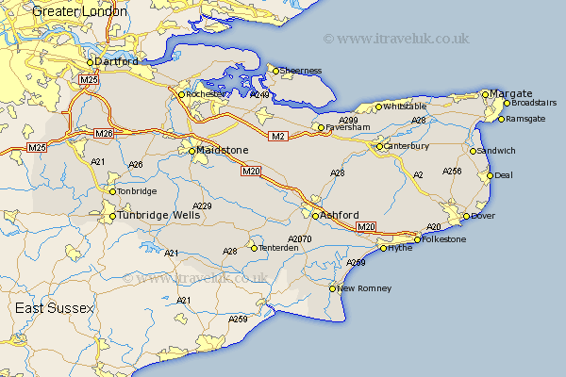
Æthelberht’s laws
Æthelberht was king of Kent, today a small county in the very southeast of England. The boundaries of his kingdom were probably roughly those of the modern county)

Slide 22
Æthelberht’s laws according to Bede
“In the year of our Lord’s incarnation 616, which is the 21st year after Augustine with his companions was sent [by Pope Gregory the Great] to preach to the nation of the English, Ethelbert, king of the people of Kent, after his temporal kingdom which he held most gloriously for 56 years, entered into the eternal joys of the heavenly kingdom. He was indeed the third of the kings in the nation of the English to hold dominion over all their southern provinces, which are divided from the northern by the river Humber and boundaries adjoining it; but the first of them all to ascend to the heavenly kingdom. . . .

Slide 23
Æthelberht’s laws according to Bede (cont’d)
‘‘King Ethelbert died on 24 February . . . and was buried in the chapel of St Martin within the church of the blessed Apostles Peter and Paul, where also Queen Berhta lies buried. Among the other benefits which in his care for his people he conferred on them, he also established for them with the advice of his councillors [cum consilio sapientium] judicial decrees [decreta iudicialia] after the example of the Romans [iuxta exempla Romanorum], which, written in the English language, are preserved to this day and observed by them; in which he first laid down how he who would steal any of the property of the Church, of the bishop, or of other orders, ought to make amends for it, desiring to give protection to those whom, along with their teaching, he had received.”

Slide 24
Is Bede to be believed?
Did Æthelberht become a Christian?
Does the text that Bede had correspond to ours? (We may be missing a prologue. The other two Kentish laws that survive from later in the 7th century both have prologues [see outline]).
Did Augustine of Canterbury bring literacy to Kent?
The possible role of Liudhard, Berhta’s bishop.

Slide 25
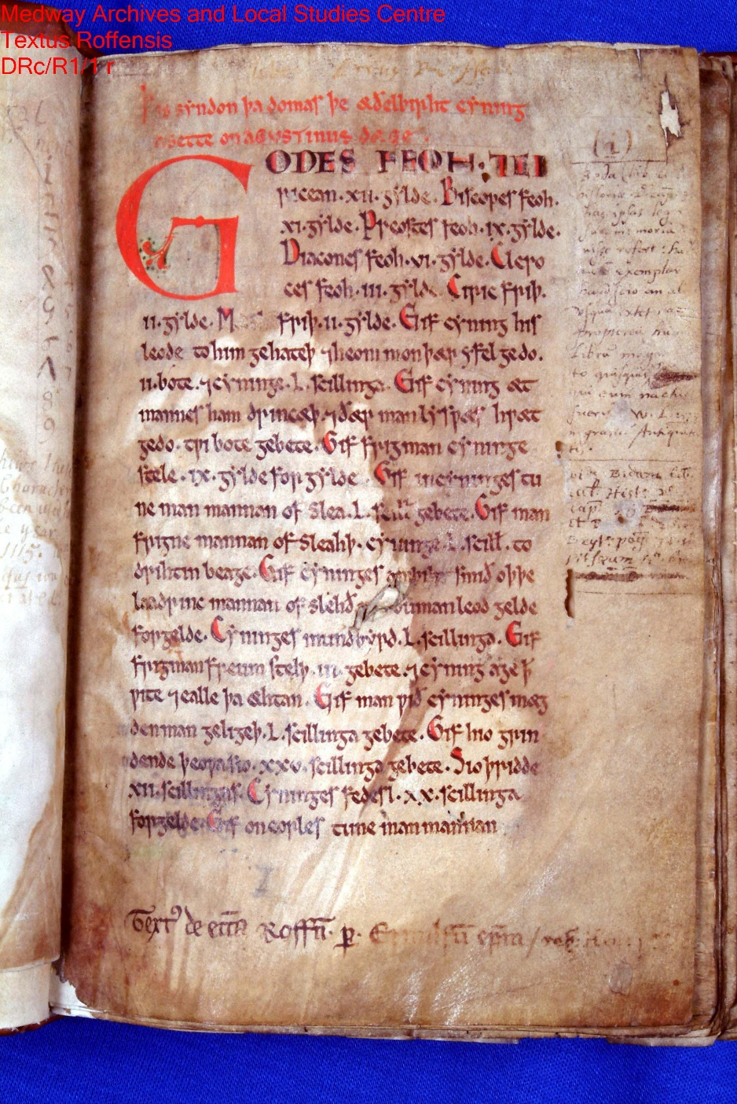
The manuscript
The first page of the only manuscript copy, the Textus Roffensis, from the collection of the Dean and Chapter of Rochester Cathedral, now housed in Rochester Cathedral.

Slide 26
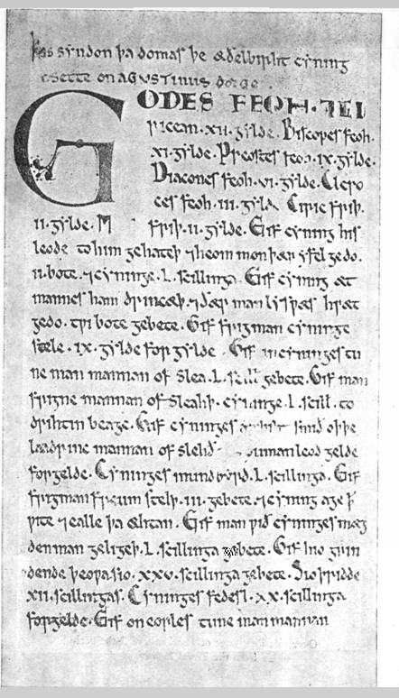
The manuscript (bw)
The first page of the only manuscript copy, the Textus Roffensis, from the collection of the Dean and Chapter of Rochester Cathedral, now housed in Rochester Cathedral.

Slide 27
Notes on the Words in Bede
decreta iudicialia. The phrase does not have a technical legal meaning, but decretum (the singular of decreta) does: a decision of the emperor in a specific legal case. Iudicialia is derived from iudex, which means ‘a judge’. The Old English for decreta iudicialia is domas, which means ‘judgments’. Cf. the Spanish for the Visigothic Laws: fuero juzgo, literally ‘the forum of the judge’.
Bede does not use either of the Latin words for ‘law’: ius, law in the general sense or ‘right’, lex, law in the specific sense or statute. The Anglo-Saxons made a similar distinction. The O-E word ae or aew also means law in a more general sense and is cognate with modGer Ehe, ‘marriage’. ‘Fundamental agreement’ might be a good translation. The earliest version of the Salic law of the Franks is called in Latin pactum legis Salicae, the agreement of the Salic law.
iuxta exempla Romanorum. Literally, “according to the examples of the Romans.” There is no Roman law in Æthelberht’s laws, not even a hint. Does this simply mean a written law? or a secular law? or like what the Germanic kings were doing in areas that were thought of as still being parts of the Roman empire?

Slide 28
Æthelberht’s Laws cc. 1–7, 10 with a Literal Translation
1. Godes feoh 7 ciricean XII gylde. God’s property and church’s 12 by payment.
2, Biscopes feoh XI gylde. Bishop’s property 11 by payment.
3. Preostes feoh IX gylde. Priest’s property 9 by payment.
4. Diacones feoh VI gylde. Deacon’s property 6 by payment.
5. Cleroces feoh III gylde. Cleric’s property 3 by payment.
6. Ciricfriþ II gylde. Church peace 2 by payment.
7. M[æthl]friþ II gylde. Assembly peace 2 by payment.
10. Gif frigman cyninge stele, IX gylde forgylde. If a freeman steals from the king, let him pay forth 9 by payment.

Slide 29
Method
Elaboration, most notably in cc. 32–71.
Analogy, implied in many of the provisions to the extent that we doubt that they are all real cases. It seems to be reasonably explicit in cc. 6–7.

Slide 30
Outline of Æthelberht's Laws
The Church cc. 1–7
The king cc. 8–17
Eorls cc. 18–19
Ceorls cc. 20–71
c. 20–31 mundbyrd, wergeld, property offenses
c. 32–71 personal injury, arranged from head to toe
Women cc. 72–77
Servants, slaves cc. 78–83

Slide 31
Basic concepts
wergeld. Wer is cognate with Latin vir, a male person; geld is our word ‘gold’ but it’s broader: literally ‘man-payment’ or ‘man-price’.
mundbyrd. The mund part means ‘protection’; it is cognate with Latin manus, ‘hand’. The byrd part is harder, but it is probably related to our word ‘border’, hence mundbyrd is ‘area of protection’.
friþ pronounced ‘frith’, cognate with Modern German Friede, ‘peace’.
bot (‘compensation’) occurs very frequently particularly in the verbal form gebete (‘let him make compensation’).
wite (‘fine’, ‘penalty’) occurs only once in c.15, but there are a number of offenses to the king’s mundbyrd.
This is clearly not criminal law, but it’s not quite civil either.
One may doubt if these are absolute liability offenses.

Slide 32
The sorts and conditions of men: A comparison of Æthelberht’s laws and Ine’s (West Saxon, roughly 695)
A TABLE OF WERGELDS
 | Æthelberht |  | Ine
 | mundbyrd | wergeld | wergeld
king | 50 | ? | ?
eorl | 12 | 300ª=6000^{b} | 1200=6000^{c}
 |  |  | 600=3000
ceorl | 6 | 100=2000 | 200=1000
læt |  | 80/60/40
esne=læt
theow
In Hlothere & Eadric 1. b. @ 20 pence to the shilling. c. @ 5 pence to the shilling.
Price lists from London in the first half of the 10th century value an ox at 30 pennies, a cow at 20, a pig at 10, a sheep at 5. Probably no ordinary ceorl in Æthelberht’s Kent could command 400 sheep, and precious few kingroups of ceorlas could.

Slide 33
What was the purpose of Æthelberht’s laws?
Writing down the laws so that people could remember them?
To fit the Christian church into the society?
To make it clear, as the Christian missionaries were telling them, that it’s o.k. to accept money compensation to settle a feud?
To do something like a penitential?

Slide 34
An insular comparison from an Irish penitential of c. 800
Ch.5 Of anger. 2. Anyone who kills his son or daughter does penance twenty-one years. Anyone who kills his mother or father does penance fourteen years. Anyone who kills his brother or sister or the sister of his mother or father, or the brother of his father or mother, does penance ten years: and this rule is to be followed to seven degrees both of the mother's and father's kin to the grandson and great-grandson and great-great-grandson, and the sons of the great-great-grandson, as far as the finger-nails. . . . Seven years of penance are assigned for all other homicides; excepting persons in orders, such as a bishop or a priest, for the power to fix penance rests with the king who is over the laity, and with the bishop, whether it be exile for life, or penance for life. If the offender can pay fines, his penance is less in proportion.
Ch. 4 Of envy. 5. . . . There are four cases in which it is right to find fault with the evil that is in a man who will not accept cure by means of entreaty and kindness: either to prevent someone else from abetting him to this evil; or to correct the evil itself; or to confirm the good; or out of compassion for him who does the evil. But anyone who does not do it for one of these four reasons, is a fault-finder, and does penance four days, or recites the hundred and fifty psalms naked.

