Slide 1
English Constitutional and Legal History:
Constitutional Developments in the 13th Century
Lecture 9
Click here for a printed outline.

Slide 2
The topic of the lecture
We now go back to the political and constitutional developments of the 13th century. The survey will include a consideration of statutes, which are very much a part of the constitutional developments in the period. In class we will consider two documents, the mise of Amiens of 1264 and the Confirmatio cartarum (Confirmation of Charters) of 1297, both of which are on the outline. The next lecture will consider a specific institution, parliament, and will close with an attempt to tease out the theory not only of parliament but also of governance by the end of the 13th century. We’ll do more with the theory next week when we consider the English and French constitutions comparatively.

Slide 3
The 13^{t}h century in general
In art the 13th is the century of the flowering of the Gothic. Most of the great Gothic cathedrals of France, Reims, Notre Dame de Paris, Amiens, date from the 13th century. Westminster Abbey, Salisbury, and Lincoln in England are Gothic cathedrals built in the French style. Let’s take a look:

Slide 4
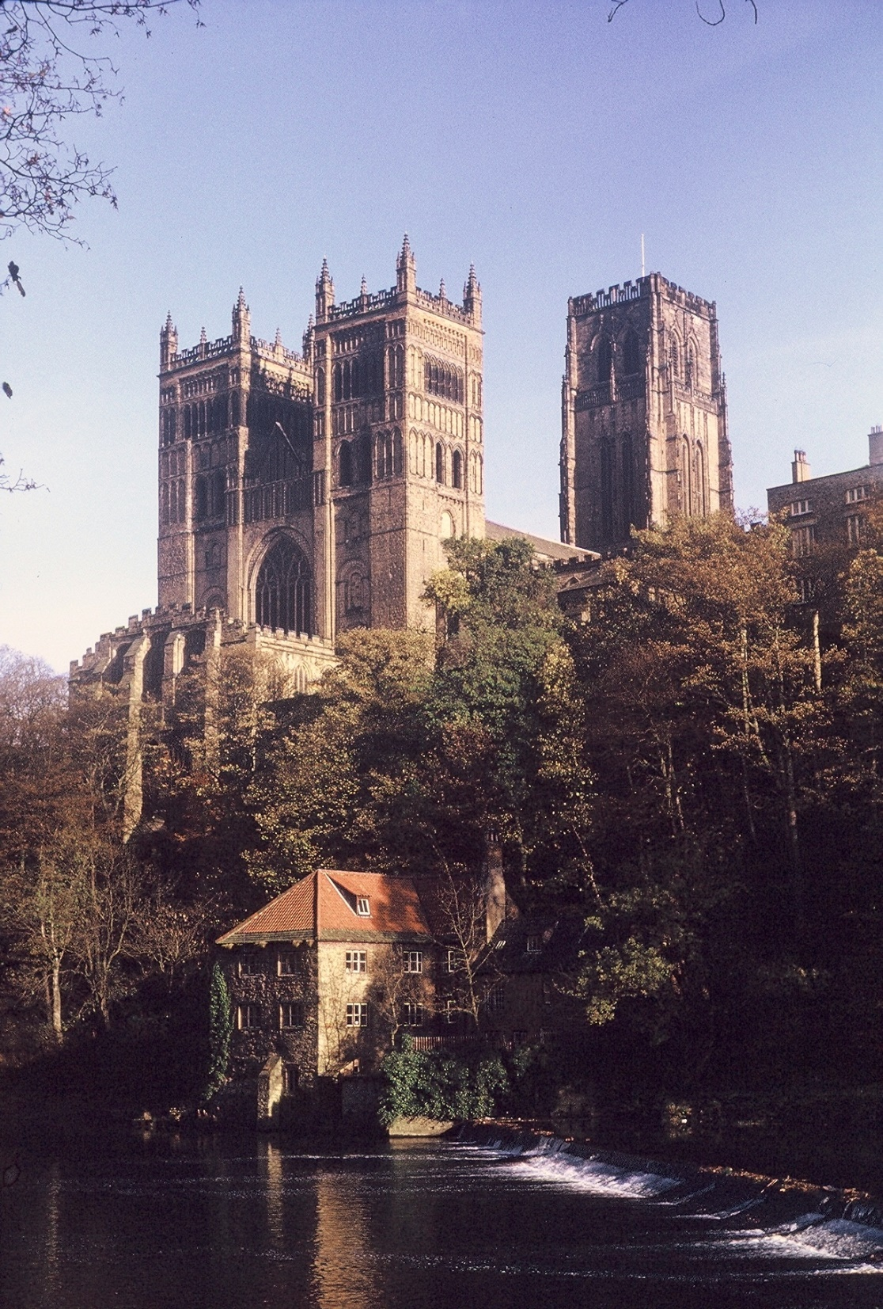

Slide 5
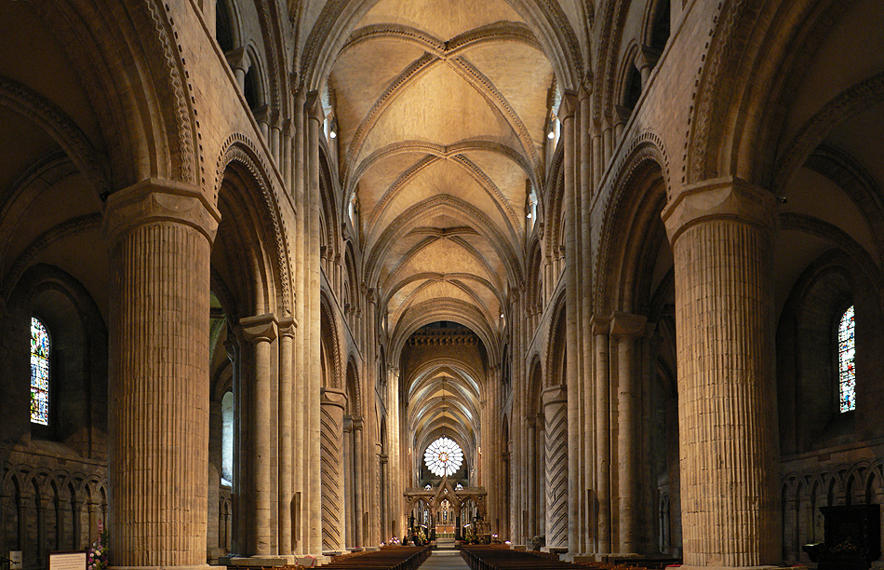

Slide 6
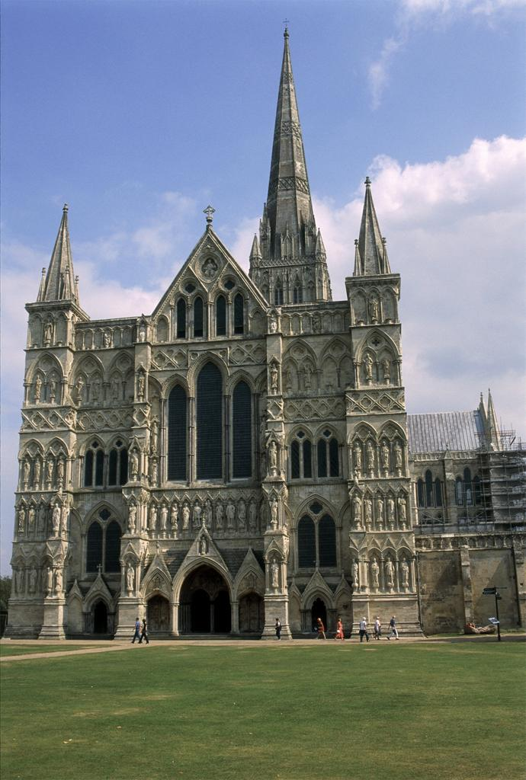

Slide 7
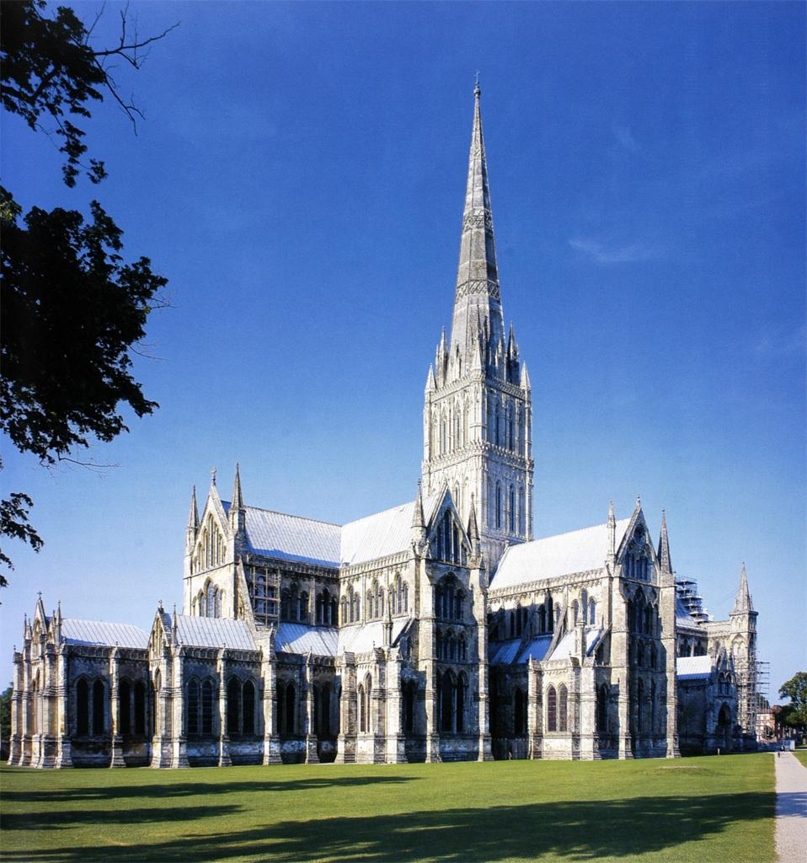

Slide 8
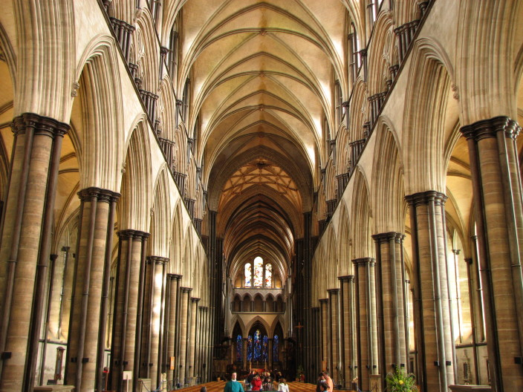

Slide 9
The operation of warranty (cont’d)

Slide 10
The 13^{t}h century in general (cont’d)
The high point of scholastic philosophy and theology—Albert the Great, Thomas Aquinas, Duns Scotus, Bonaventure
New religious orders (Franciscans and Dominicans)
Height of the temporal power of the papacy—Innocent III, Gregory IX, Innocent IV, ending with Boniface VIII at the end of the century
The great glosses of Roman and canon law; Bracton and Beaumanoir

Slide 11
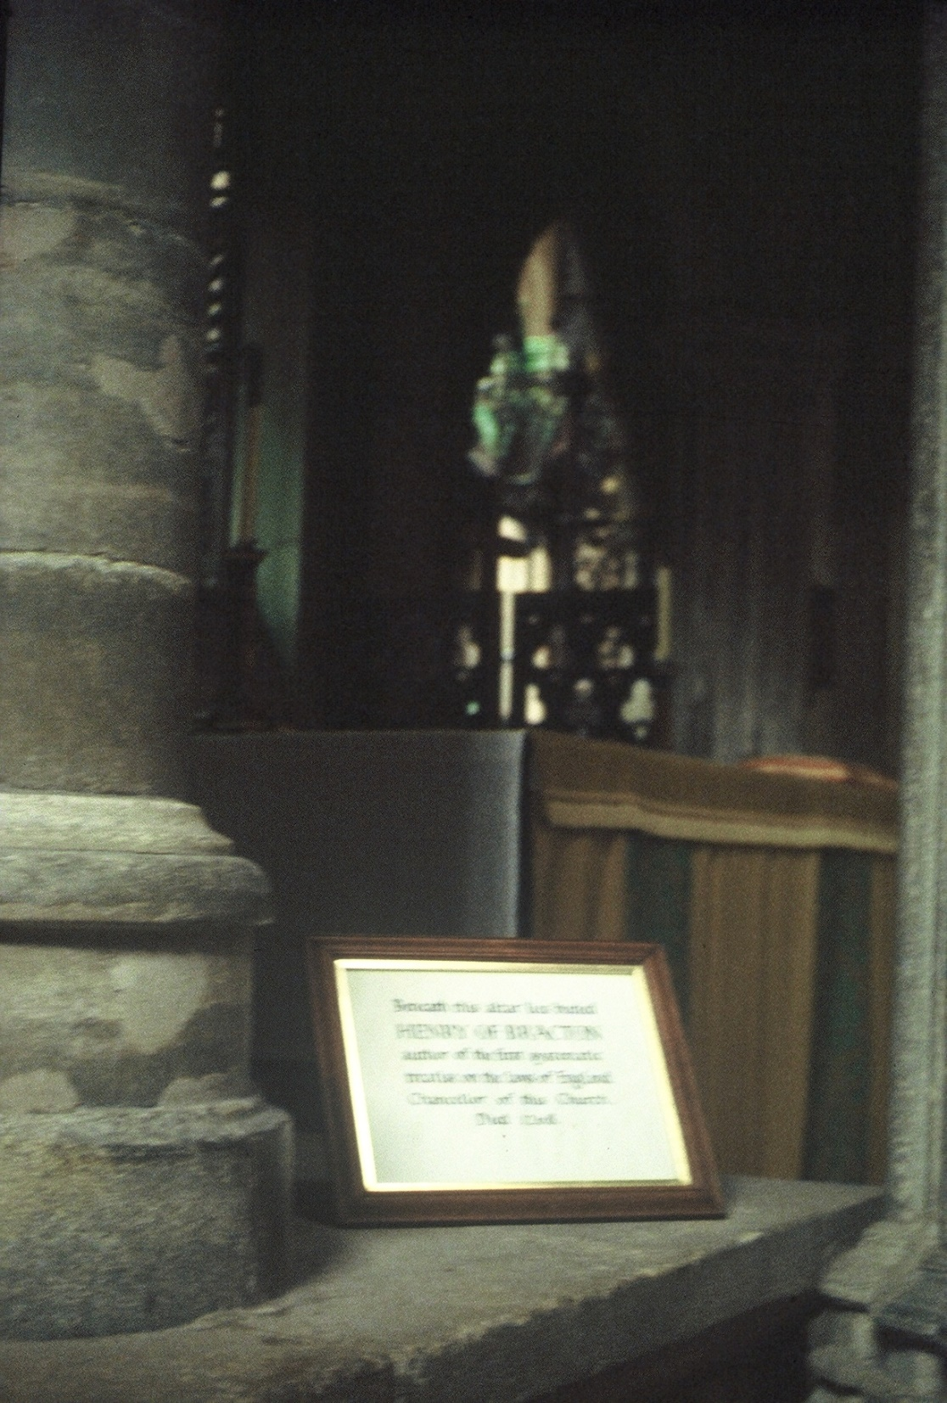

Slide 12
Basic English chronology – 13th century
Henry III — 1216–1272 — 57 years — died at age 65
Edward I — 1272–1307 — 35 years — died at age 68
1232 — End of Hubert de Burgh’s justiciarship
1258–59 — Provisions of Oxford, Provisions of Westminster, Treaty of Paris, the dynasty becomes Plantagenet rather than Angevin
1264 — Mise of Amiens, Battle of Lewes, Simon de Montfort’s 1st parliament
1265 — Simon de Montfort’s 2nd parliament, Battle of Evesham
1266 — Dictum of Kenilworth
1284 — Statute of Wales
1285 — Westminster II, De Donis
1290 — Westminster III, Quia Emptores
1292 — Judgment for John Baliol, beginning of Scottish wars
1295 — “Model” Parliament
1297 — Confirmatio cartarum
1303 — Treaty of Paris with Philip the Fair
.
.

Slide 13
Developments in governance, chief justiciar, Exchequer, and chancellor (early Henry III).
The chief justiciar is converted into the chief justices of the court before the king (coram rege) and of the common bench (bancum commune).
The Exchequer becomes more routine; the barons of the Exchequer become more like judges and less like trusted councilors of the king.
The chancellor seems to lose power in this period, and the wardrobe (a household department) emerges as the most important department dealing with king’s money.
Most, if not quite all, of these changes can be associated with the ending of Henry III’s minority.

Slide 14
The fall of Hubert de Burgh
Hubert de Burgh, the last of the great justiciars, is firmly associated with the minority of Henry III.
Hubert fell both because Henry becomes sick of his minority and because a group of men from Poitou in France, lead by Pierre des Roches, the bishop of Winchester and a survivor from John’s reign, and his nephew Pierre des Rievaulx, gained power.
Kings that begin as minors don’t have a good track record.

Slide 15
Foreign politics and nationalism
Henry III, Isabelle of Angoulême, Eleanor of Provence
Henry III and Gascony
Edmund and Sicily
Richard of Cornwall and the Holy Roman Empire
The barons were chary of these foreign adventures
Edward I encountered similar difficulties

Slide 16
Troubles between 1232 and 1258
Opposition to the role of the Lusignans and the Savoyards
Money
The “paper constitution” of 1244:
  Magna Carta to be confirmed
  barons to control the chancellor and the exchequer
  regular consultation with a defined great council.

Slide 17
The Barons’ Wars (1258–1266) (Mats., pp. V-15 to V-25)
The Barons’ Wars (1258–1266) (Mats., pp. V-15 to V-25): Focus on the council and on the sheriffs. Creation of the escheator. Relationship to parliament problematic. The notion of ‘the community of the realm’.
Henry agrees to reform (1258, Mats., p. V-15): That “the state of our realm (status regni nostri) be ordered, rectified, and reformed”
.

Slide 18
The Barons’ Wars (1258–1266) (cont’d)
The Petition of the Barons (1258, Mats., pp. V-15 to V-19). Like Magna Carta, they begin with inheritance. C.1: “In the matter of inheritance, the earls and barons ask that the firstborn son, or daughter, being of full age and having proved his right to do towards his lord what he ought to do, shall have free entry after his father to his father’s possessions; and that the chief lord shall have only formal seisin, by one of his bailiffs, whereby nothing may be taken by the bailiff from the profits of the land or from the rents..” Clause 27 begins a development that will end in the statute De Donis (1285). “Further, they seek a remedy concerning alienated marriage portions, as in cases of this kind: if anyone has given to another a carucate of land as a dowry along with a daughter or sister, to have or to hold to them and their heirs issuing from the daughter or sister, provided that if the daughter or sister shall die without any heir of her body, the land and all appurtenances shall revert entirely to him who gave the land as a dowry, or to his heirs; and whereas the gift is not absolute but conditional, nevertheless, women, after the deaths of their husbands, in their widowhood, give or sell the dowries, and enfeoff them as they choose, although they have no heirs of their bodies, and so far enfeoffments of this kind have not been annulled.”

Slide 19
The Barons’ Wars (1258–1266) (cont’d)
The provisions of Oxford (1258, Mats., V-19 to V-21): “Thus swore the community of England at Oxford … .” The notion of community, the notion of the chief officers, the wardrobe. The 3 annual parliaments may or not be the ancestor of the modern institution. An elaborate scheme for implementation.
The provisions of Westminster (1258, Mats., V-21 to V-22). Much that has to do with the justices in eyre, and much that has to do with lords’ courts. Most renewed in the statute of Marlborough of 1267. A division between public and private law?
Summoning of knights of the shire for the meeting at Windsor (1261, Mats., pp. V-22 to V-23). Probably not to be connected in any direct way with the shire knights of Parliament.
The mise of Amiens (1264, Mats., pp. V-23). I don’t find the document to be as autarchic as some do. (See the outline for the document where you can make up your own mind.)
The battle of Lewes, May 1264.

Slide 20
The Barons’ Wars (1258–1266) (cont’d)
The first and second parliaments of Simon de Montfort (1264-5, Mats., pp. V-23 to V-24). The second is famous, perhaps too famous, because it contains a summons of the burgesses of the boroughs.
The role of the lord Edward.
The battle of Evesham, August 1265. Death of Simon de Montfort.
Dictum of Kenilworth (1266, Mats., pp. V-24 to V-25). Announcing the principle of no private revenge didn’t prevent it from happening, but it did at least establish the principle.

Slide 21
The reign of Edward I (1272–1307)
The Welsh wars (culminates in the Statute of Wales of 1284)
The Scottish wars (begin 1292)
The French wars (end 1303)
Statutory and parliamentary activity (throughout the reign)
Confirmatio cartarum (1297)
Quo warranto (1278-1294): the earl of Warenne and the rusty sword
Carta mercatoria (1303)

Slide 22
The legislative activity of Edward I
Not all of Edward I’s statutes are parliamentary. There are 27 Harvard Law School manuscript statute books that contain statutes of Edward I, perhaps an unbiased sample of all such manuscripts. There are some 45 items from the reign of Edward I that someone at some point thought of as statutory and that appear in the printed Statutes of the Realm. All but five occur in one or more of the 27 HLS manuscripts. A much smaller group appears in all or most of them. The table on the following slides lists the most common items in chronological order with a parenthetical indication of the number chapters that the item contains and the number of manuscripts in which it occurs. You might want to pause the recording to look at the table. (It is also on the outline.) There are many things that could be done with this data and what follows in the lecture is but a few of many possibilities.

Slide 23
The legislative activity of Edward I (cont’d)
Magna Carta (1225, 1297) (37 c.) (22 ms.; 3 contain 1215 version, 2 have missing quires where it would have appeared).
Forest charter ([1217], 1225, 1297) (16 c.) (20 ms.; 4 have the 1225 version)
Provisions of Merton (1235) (11 c.) (26 ms., missing quires in the 27th probably contained it))
Statute of Marlborough (1267) (29 c.) (26 ms., missing quires in the 27th probably contained it)
Statute of Westminster I (1275) (51 c.) (27 ms.)
Statute of Gloucester (1278) (15 c.) (26 ms.)
‘Exposition’ (explanationes) of statute of Gloucester (1278) (not capitulated) (20 ms.)
De viris religiosis (Statute of Mortmain) (1279) (not capitulated) (24 ms.)
Statute of Merchants (Acton Burnell) (1279) (not capitulated) (10 ms.)

Slide 24
The legislative activity of Edward I – the HLS sample (cont’d)
Statute of Westminster II (1285) (50 c., the first of which is De donis) (27 ms.)
Statute of Winchester (1285) (6 c., instructions to the sheriff about criminal matters) (24 ms.)
Statute of Merchants (1285) (not capitulated) (16 ms.)
Circumspecte agatis (1285) (not capitulated, deals with the jurisdiction of the ecclesiastical courts) (22 ms.)
Statute of Westminster III (1290) (3 c., the first of which is Quia emptores) (26 ms.)
Statutum de Quo warranto (1290) (not capitulated) (15 ms.)
Statutum de Quo warranto novum (1290) (not capitulated) (10 ms)
Statutum de presentibus vocatis ad warrantum (Statute concerning calling to warranty those who are present) (1292) (not capitulated) (14 ms.)

Slide 25
The legislative activity of Edward I – the HLS sample (cont’d)
Statute of waste (1292) (not capitulated) (10 ms.)
Statutum de illis qui debent poni in iuratis et assisis (Statute concerning those who ought to be put on juries or assizes) (1293) (not capitulated) (13 ms.)
Statutum de finibus levatis (Statute of [Levying] Fines) (1299) (4 c.) (20 ms.)
Statutum de coniunctis feoffatis (Statute of Joint Tenants) (1306) (not capitulated) (16 ms.)

Slide 26
What can we make of the HLS sample?
First, what it not there. Of the five statutes that appear in the Statutes of the Realm and do not occur in any of our manuscripts the only one that could be regarded as major is the Statute of Wales. The reason for its omission would seem to be that our makers of statute-books were concerned only with England. The fact that they also omit the fairly important set of Statutes for the city London of 1285 suggests that they were concerned only with statutes that were thought to apply to England a whole.
Second, 22 out of the 45 possibilities appear in 10 or more of the 27 manuscripts that contain statutes of Edward I. The number, however, that occurs in all, or virtually all of them, is much smaller: Magna Carta (always at the beginning), Merton, Marlborough, Westminster I, Gloucester, Westminster II, and Westminster III. Not far behind are the Forest Charter (which will follow Magna Carta), Mortmain, and Winchester, with 24 examples, Circumspecte agatis, with 22, and Fines and the exposition of Gloucester, with 20.

Slide 27
What can we make of the HLS sample? (cont’d)
These numbers are probably a pretty good indication of what the makers of our statute books thought was important. They also give some hints of their sense of chronology. Their story begins with Magna Carta. None of our books includes any of the assizes of Henry II. Their story does, however, include Henry III. Merton is there, even though it was not promulgated in anything that looked to them like a parliament, as well as Marlborough, which was.
Parliamentary statutes dominate. Marlborough, Westminster I, Gloucester, Westminster II, and Westminster III are all parliamentary statutes, and they take up most of pages. The two charters, however, Merton, Mortmain, Winchester, Circumspecte agatis, Fines, and the exposition of Gloucester are not parliamentary statutes, and there is no suggestion that they are any less authoritative than the parliamentary statutes.

Slide 28
What can we make of the HLS sample? (cont’d)
The level of detail is quite staggering. The number of chapters give some sense of it: Westminster I (51 c.), Westminster II (50 c.) Magna Carta (37 c.), Marlborough (29 c.), and so on. This may be one reason that these statutes get copied so often.
But more broadly, what did these statutes do? They made fixes, many fixes, in existing intuitions. Some of the fixes were quite clever and lasted for a long time. There was little, however, that these statutes did that was truly innovative. They took the system as it was and tweaked it to make it work better. They did not rethink the system.

Slide 29
What did the legislation of Edward I do? (focusing on Quia emptores [1290] and De donis [1285])
  It is sometimes said that the statute Quia Emptores in 1290 made the fee simple in land freely alienable. The same ill-considered statements about the fee simple will sometimes add that it took until the Statute of Wills of 1540 to make the fee simple devisable by will or testament. The implication of the statement, however, is correct. As of 1300 the fee simple was freely alienable inter vivos but not devisable. The question is whether the free alienability of the fee simple inter vivos is the result of the statute Quia emptores.
  It is not. The reason that the fee simple is freely alienable and not devisable was because of the logic of warranty. The development had already taken place around the beginning of the 13th century. The statute Quia Emptores simply put an end to a practice whereby lords were being deprived of the feudal incidents, the only thing about lordship that was worth much any more. The statute did so by abolishing subinfeudation. All conveyances of the fee must now be by way of substitution. The lords gave up their by-now now nominal right to object to new tenants.

Slide 30
What did the legislation of Edward I do? (cont’d)
  The fee tail more the product of the statute De donis of 1285 than the fee simple is the product of Quia emptores. De donis, however, is the product of a complicated development that begins with the gift in maritagium. Because no homage is taken in such gifts, the law must develop rules shorn of the key element that it had used in other areas, warranty. First comes curtesy, what would have happened if the lord had taken his son-in-law’s homage: the son-in-law gets a life estate if the daughter dies before the son-in-law. Then comes a curious rule that upon the birth of issue the couple have the right to alien the fee simple. This rule is reversed by the statute De donis that says that if this happens the heirs of the body of the couple may bring what is called a new form of action, formedon in the descender, to get it back. The statute is remarkably unclear about how the long the fee tail is to last; that is an issue to which we will have to return.

Slide 31
What did the legislation of Edward I do? (cont’d)
  The third type of freehold estate that one may have in the later middle ages is an estate for life only. Most of the later medieval life estates were held by widows or widowers. The widow got dower, a life estate in one-third of her husband’s lands. The widower got curtesy, a life estate in all of his wife’s lands. Dower is treated only in passing in Edward’s legislation, curtesy not at all. Both are also rather old consequences of the logic of warranty, the first from the extension of warranty to benefit the widow/dowager and the second the logical consequence of the fact the lord will normally take the homage of the husband for the wife’s land, and, by extension, what would have happened had he taken the husband’s homage even though he did not.
  The bottom line is that the legislation of Edward I made fixes in the fee simple and the fee tail and did little or nothing with dower and curtesy. The system of estates in land was somewhat reformed but the system as a system remained basically unchanged.

Slide 32
Summary
  We now have an answer to some very curious aspects of English land law both the fact that most freehold tenures are freely alienable inter vivos and not devisable and that the widower gets a life estate in all his wife’s land but the widow only 1/3. In both cases these oddities are the product of warranty, and have nothing to do with the legislation of Edward I.
  The legislation of Edward I must be seen for what it was, fixes. Taken together the fixes were important. They were still lecturing on the legislation of Edward I in the Inns of Court in the 17th century. It was not, however, legislation in the modern sense. No one in the time of Edward I thought that the whole system could be reformed by legislation.

Slide 33
Summary (cont’d)
  The source of English law is not the written law of Rome or that of the church. This is not to say that both were unimportant, but that is not where law comes from. The source of English law is custom, and custom means a lot of things. It can refer to ideas that develop over centuries, such as, that a widow is entitled to a life interest in some of her husband’s lands, or it can refer to the practice of a particular court (and the central royal courts are clearly the courts whose practices are becoming dominant), but it can also refer to what is right. There are those who argue that the legislation of Edward I is not conscious of innovation. I’m not sure that that is quite right. There are too many references to what the law was before the statute and what the law was after the statute to make us believe that people simply thought that the highest court in the land was making a judgment about what the law always was. It might be better to imagine the legislation as innovative, but innovative within a rather narrow context.

